Slide 1
How did your teachers teach vocabulary when you look back on your elementary and secondary school days?
What are characteristics of effective teaching?

Slide 2
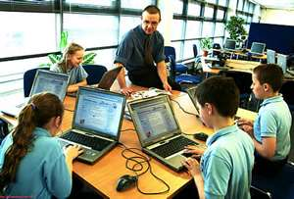
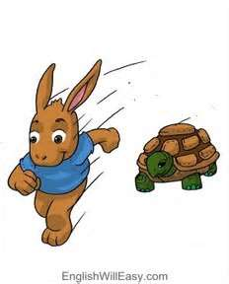
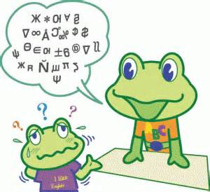
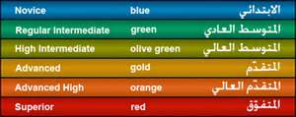
Effective teaching

Slide 3
CONTENT OBJECTIVES: Students will be able to
identify the effective teaching skills after watching two video clips and apply them in their practice teaching.
LANGUAGE OBJECTIVES: Students will be able to
demonstrate how to teach the vocabulary “ a Bundt cake” effectively after speaking about effective teaching and reading All about a Bundt Cake.

Slide 4
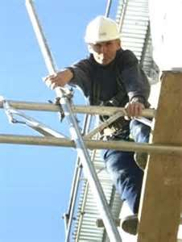
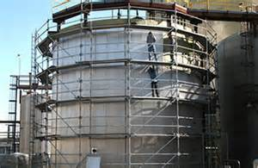
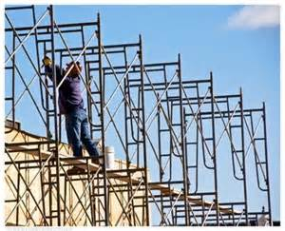
Key Vocabulary
Scaffold /skæfəld/ n, v
a temporary metal or wooden framework that is used to support workmen and materials during construction.
A teacher’s temporary help for students to do something that they are unable to do on their own.

Slide 5
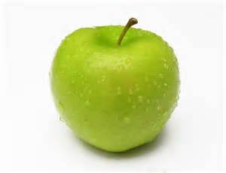
Key Vocabulary
Realia /riæliə/ pl. n
real-life facts and material used in teaching

Slide 6
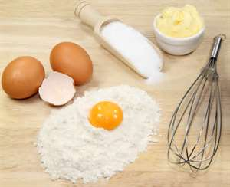
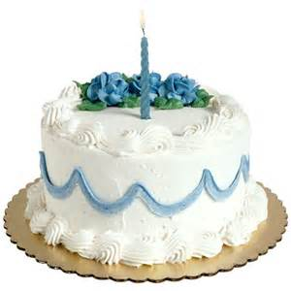
Key Vocabulary
Ingredient /ɪngridiənt/ n.
a component of a mixture, especially in cooking
Flour, eggs, and sugar are the main ingredients in the cake.

Slide 7
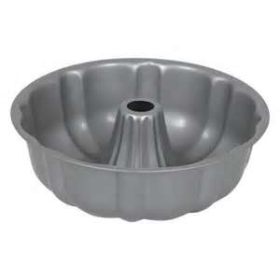
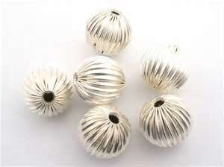
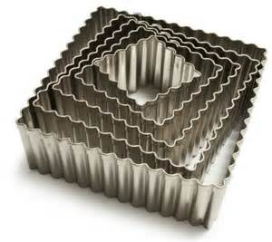
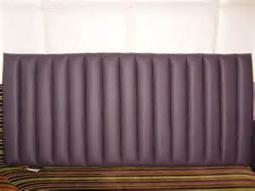
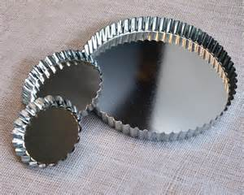
Key Vocabulary
Fluted /flutɪd/ adj.
having grooves
Fluted Tube Pan

Slide 8
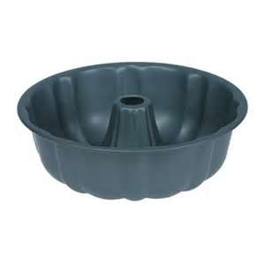
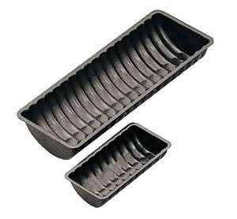
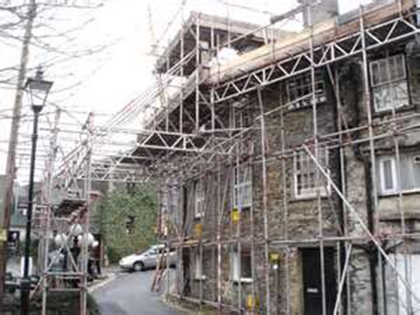
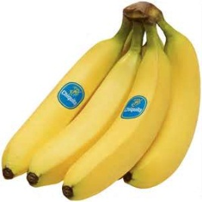
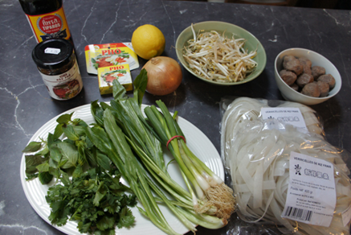
Key Vocabulary
1
Scaffold
Realia
Ingredient
Fluted
2
3
4

Slide 9
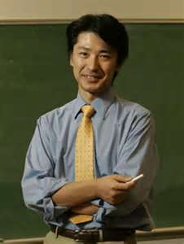
Paul Kei Matsuda (Professor of English at Arizona State University)
Situated learning in practice: This dog
shows an example,
scaffolds the task by breaking it down into steps,
provides encouragement,
walks along and
provides a safety net as the puppy tries it.
adapted from his Facebook (Mar. 8. 2013)

Slide 10
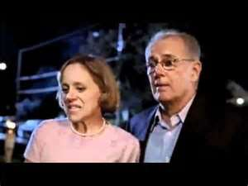
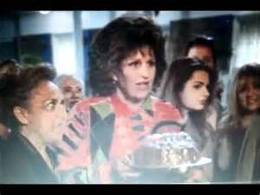
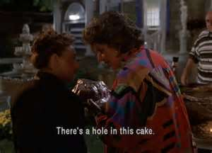
Bundt!
Bundt!
Bundt!
Boont?
Bonk?
Bundt!
There’s a hole in this cake.

Slide 11
Task Directions
·
1. Teach what “a Bundt cake” is to your students.
2. You can use any material and teaching skills to teach efficiently including All about a Bundt cake provided.
(You can create your own material and your own way!)
3. One student from each group will demonstrate teaching.
4. Preparation time will be 5 min.
5. Demonstration time will be 2 min. per each group.

Slide 12
Guidelines
1. Refer to Matsuda’s comments and characteristics of effective teaching we mentioned.
2. Pay attention to your learner’s level.
3. While one group is teaching, the other groups will play students.

Slide 13
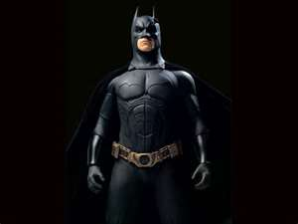
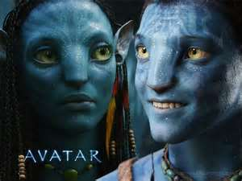
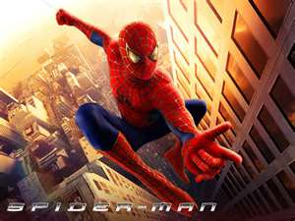
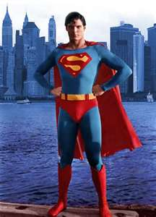
Wrap up with a BOMB!

Slide 14
$ 100
Q. What is scaffolding?
A. It refers to teacher’s intended and temporary help for students to accomplish a task that seems to be unable to be managed on their own.

Slide 15
$ 250
Q. Tell us any three characteristics of effective teaching.
A. student-centered teaching
scaffolding
encouragement / feedback
show an example / modeling
comprehensible input
consider learners’ level
use of technology
appropriate teaching pacing, etc.

Slide 16
$ 500
Q. Tell us any two things about a Bundt cake.
A. It’s a noun.
It is baked in a Bundt pan.
It has a hole in it.
We need flour, egg, milk, etc, for it.

Slide 17
Sorry, you lose everything.

Slide 18
You can take all the money from the team of your choice.

Slide 19
You get $ 350 !!!

